Slide 1
Admin Bouncers
How Endpoint Privilege Management Keeps Your Local Admin Party Exclusive!

Slide 2
Agenda
Introduction
What exactly is the problem?
Who is this Suite guy?
EPM, wasn’t that Entra Permission Management?
Fine, what can I work with?
Pudding time!
Q&A
Notes:
Introduction (5 minutes)
Welcome and session objectives.
Briefly introduce the problem of over-privileged users and the risks of local admin rights.
Understanding the Risks (10 minutes)
Discuss the common challenges and security risks associated with local admin rights.
Share statistics or stories of security breaches due to excessive privileges.
Intune Suite Overview (10 minutes)
Introduce Microsoft Intune Suite as a solution for managing and securing devices.
Highlight its role in endpoint privilege management.
Endpoint Privilege Management (EPM) (10 minutes)
Explain what EPM is and how it enhances security.
Discuss how EPM can eliminate the need for local administrators.
Elevation Types (10 minutes)
Delve into the three elevation types: automatic, user-confirmed, and support-approved.
Provide examples or scenarios for each type.
Demos (10 minutes)
Live demonstrations of EPM in action.
Show how to set up each elevation type in Intune.
Q&A and Closing (5 minutes)
Open the floor for questions.
Summarize key takeaways and thank attendees for their participation.

Slide 3

Who am I?
Jens Du Four
Linkedin.com/in/jensdufour
Jensdufour.be
Cloud Endpoint TS @ Microsoft
Traveler
Musician
Beekeeper

Slide 4


Slide 5

What is the problem?
All-powerful access
Pass-the-hash attacks
Lateral movement
Common passwords
Lack of visibility

Slide 6
Who is this Suite guy?
Intune Suite
Add to Plan 1 to utilize these solutions*
Remote Help
Endpoint Privilege Management
Advanced Analytics
Enterprise Application Management
Cloud PKI
All Intune Plan 2 features
Prerequisite
Intune Plan 1
Intune Plan 1
Included in EMS E3 or Microsoft 365 E3, ME5, F1, F3, and Business Premium plans
Cross-platform endpoint management
Endpoint security built in
Endpoint analytics
App protection policies
Shared device management
Device compliance
Risk and app based conditional access
Proactive remediation
Integrated Microsoft 365 and security
Intune Plan 2
Add to Plan 1 to utilize these features
Tunnel for Mobile App Management
Mobile firmware update management
Specialty device management
Multiple managed accounts (future)
Prerequisite
Intune Plan 1

Slide 7

EPM, wasn’t that Entra Permission Management?
Well, yes, but it’s not this!
Run elevated actions as a standard user
Windows/MacOS (in the future)
Enforce least privilege access
Zero Trust Framework
“Lock it down!” VS “Let me do my job!”

Slide 8
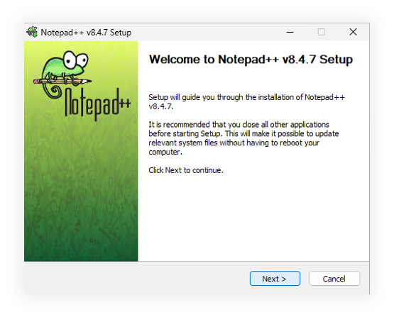
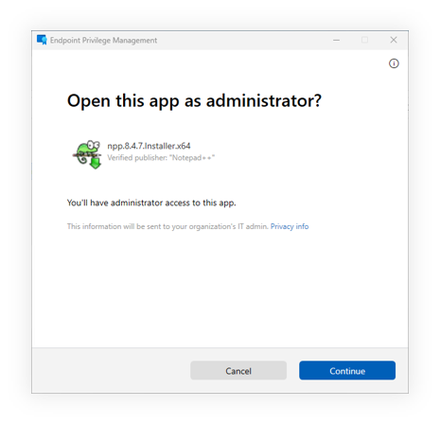
Trigger me, please!
EPM identifies a process
User selects “Run elevated”

Slide 9
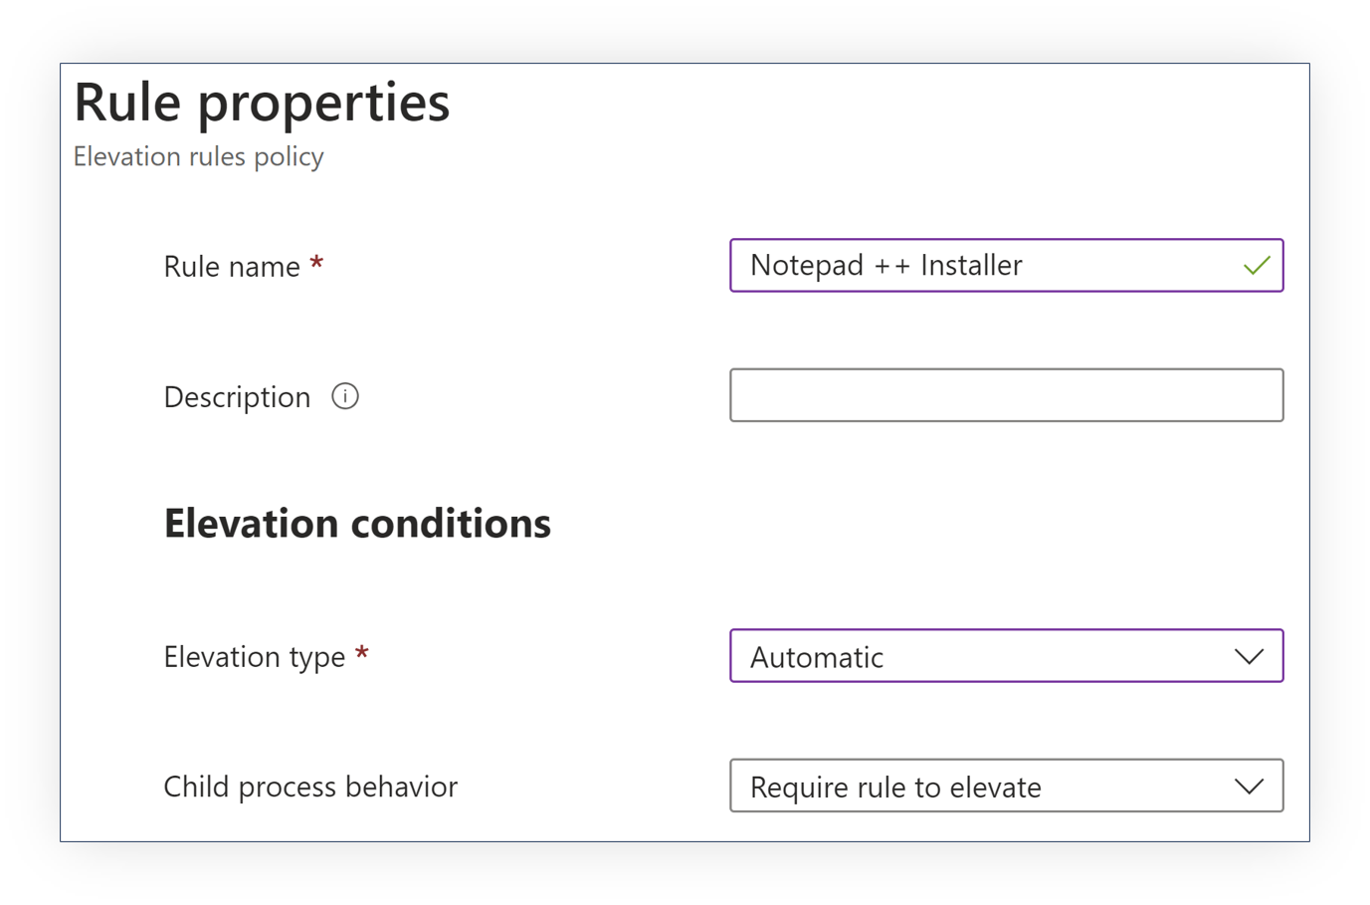
Fine, what can I work with?
Automatic elevation
Audit trail
Opaque to the end-user
User-confirmed elevation
Support-approved elevation

Slide 10
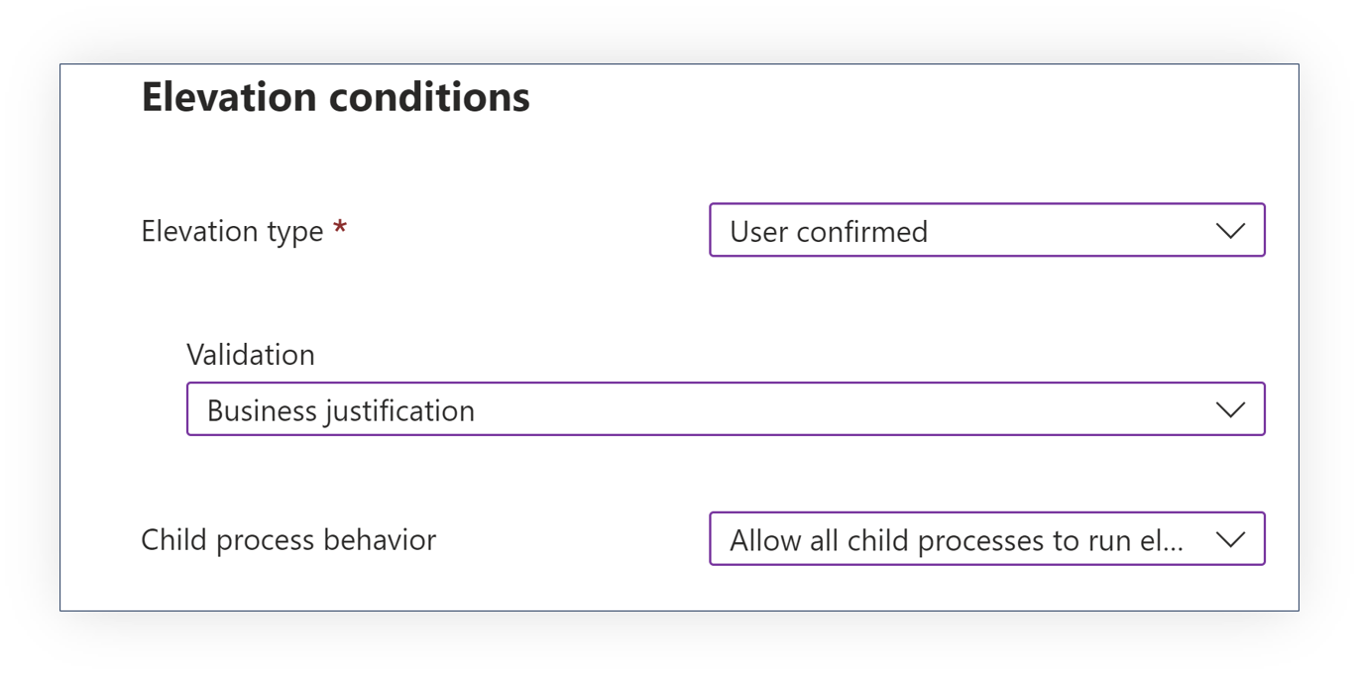
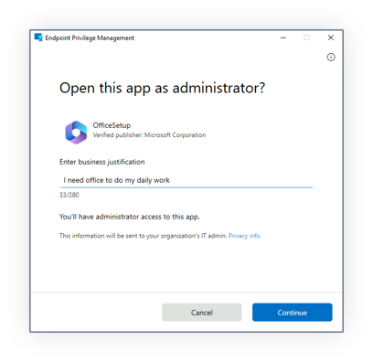
Fine, what can I work with?
Automatic elevation
User-confirmed elevation
Audit trail
Additional controls
Only a constrained set of binaries can be elevated
Bouncers check the guest list!
Support-approved elevation

Slide 11
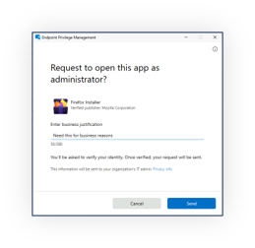
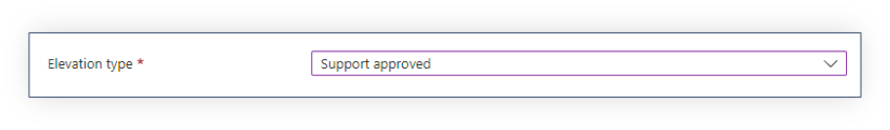
Fine, what can I work with?
Automatic elevation
User-confirmed elevation
Support-approved elevation
Audit trail
Bouncers can approve uninvited guests!

Slide 12

Pudding time!

Slide 13

Q&A

